Slide 1
Main Figures

Slide 2


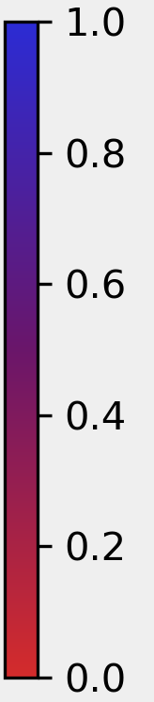
A
B
C
Analysing UK government services
AST equations
Example service
task content
Distribution of AST
index scores
1 domain (.gov.uk)
468 Organisations
(i.e., 44 departments, 424 executive agencies and public bodies)
AST_{k} = RC_{k} + RM_{k} – NRA_{k} – NRI_{k} – NRM_{k}
where RC_{k} , RM_{k} , NRA_{k} , NRI_{k} and
NRM_{k} are computed using the equation:
where T is the task content, j indicates the five task groups, and k stands for each of the 201 transactional services.
Task group Count
NRA 0
NRI 1
RC 8
RM 1
NRM 0
Total 10
AST_{k} = 1
AST = 0.9
Get a passport urgently: Renew or replace a passport urgently with the 1 day Premium service or the 1 week Fast Track.
number of tasks in task
group j in service k
total number of tasks
in service k
Web
data
.gov.uk
API
Linked
data
T_{jk} =
Historical
service
data
Dataset of active
online services
(n=377)
Transactional
services
(n=201)
AST_{k} = 0.75
AST = 0.57
Apply for a basic
criminal record check: How to apply for a basic DBS check to get a copy of your criminal record, and
what you must provide.
D
Example service tools and methods of work description
Tool or method Description
Imputation
via web
data
Data augmentation
with transaction
volumes
Aim 2: Estimate
the potential of
automation and AI
Interpersonal
Interaction
Team
Structure
Manual document
checking
Form types
There is some degree of interpersonal interaction between individual users and service providers, but this is limited in scope and volume (e.g., a call-in to the relevant department to request information)
Internal administrative staff: civil servants in the respective government department or agency
None
Webpage (e.g., HTML) and document-based forms (e.g., PDF)
AST_{k} = 0.5
AST = 0.38
Appeal against a visa or immigration decision: You may need a visa to come to the UK to visit, study or work. You can appeal to the First-tier Tribunal (Immigration and Asylum Chamber).
High-volume
services graded with rubric (n=20)
Aim 1: Construct network of government organisations and quantify scale of service delivery
PGenAI rubric scoring guide schematic
Grade Description
Δ Yearly Count
High
potential
GenAI applicable to ≥ 75% of tasks; there is no interaction; only internal administrative staff
Medium
potential
GenAI applicable to ≥ 50% of tasks; some interaction;
internal administrative staff or tribunal
Low
potential
GenAI applicable to < 50% of tasks; some/high degree of interaction; internal administrative staff or tribunal
AST_{k} = 0
Transactional public
services (n=201)
No
potential
GenAI applicable to < 50% of tasks; high degree of interaction; internal administrative staff and tribunal
Year

Slide 3
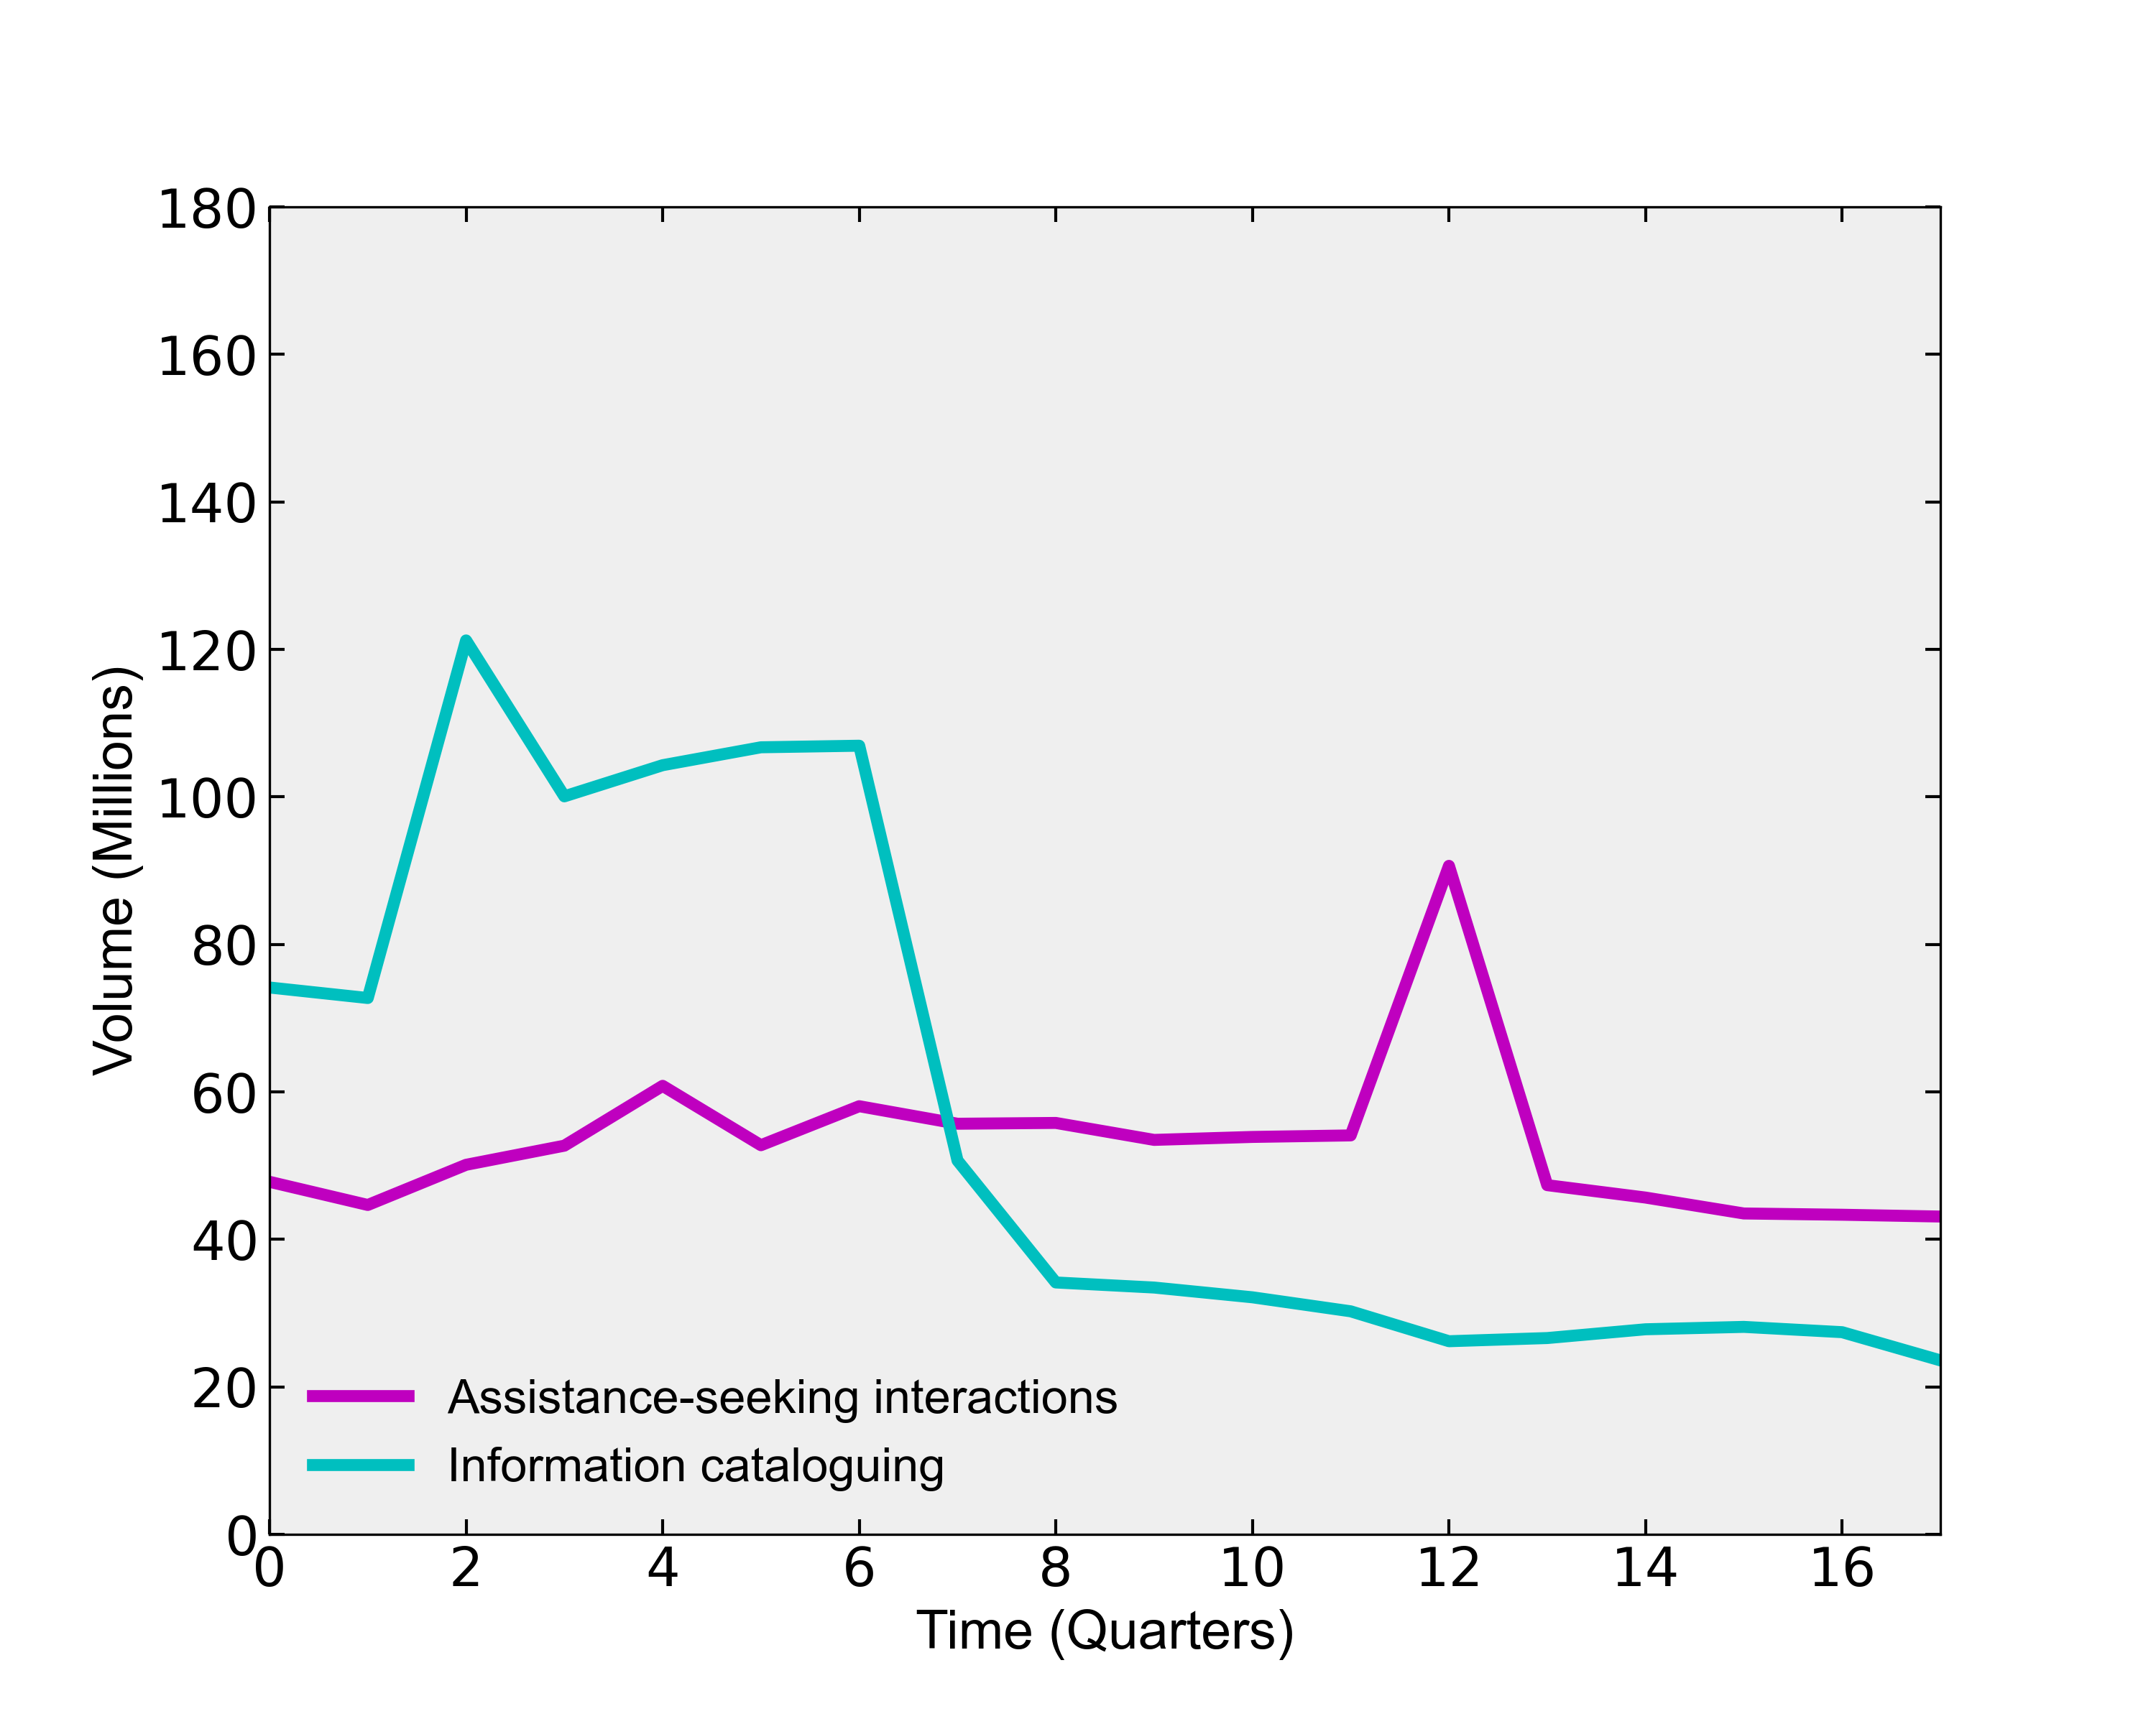
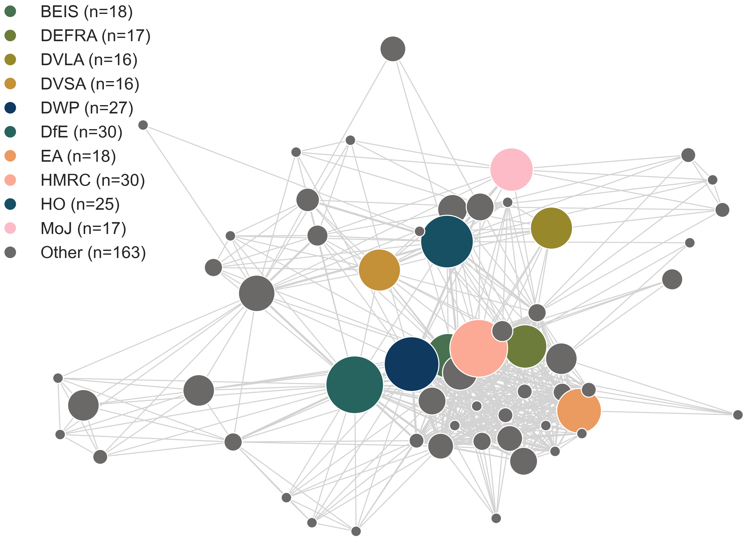
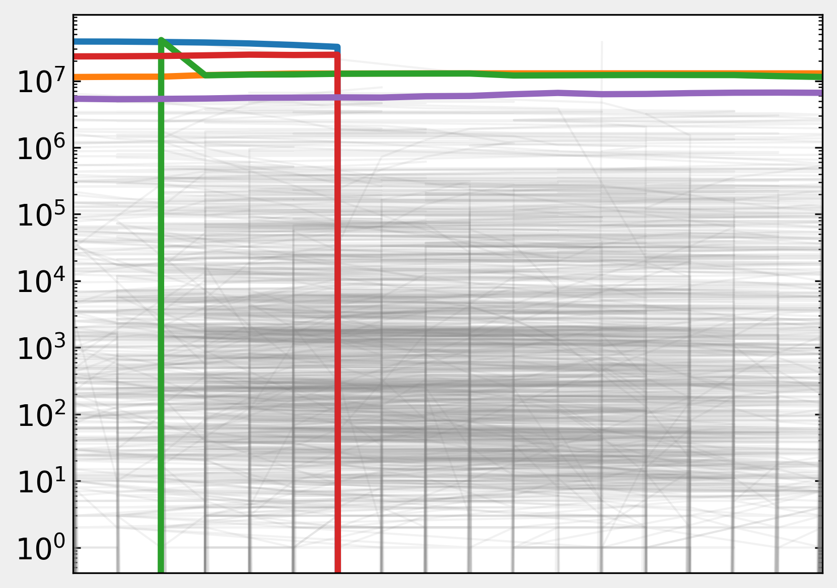
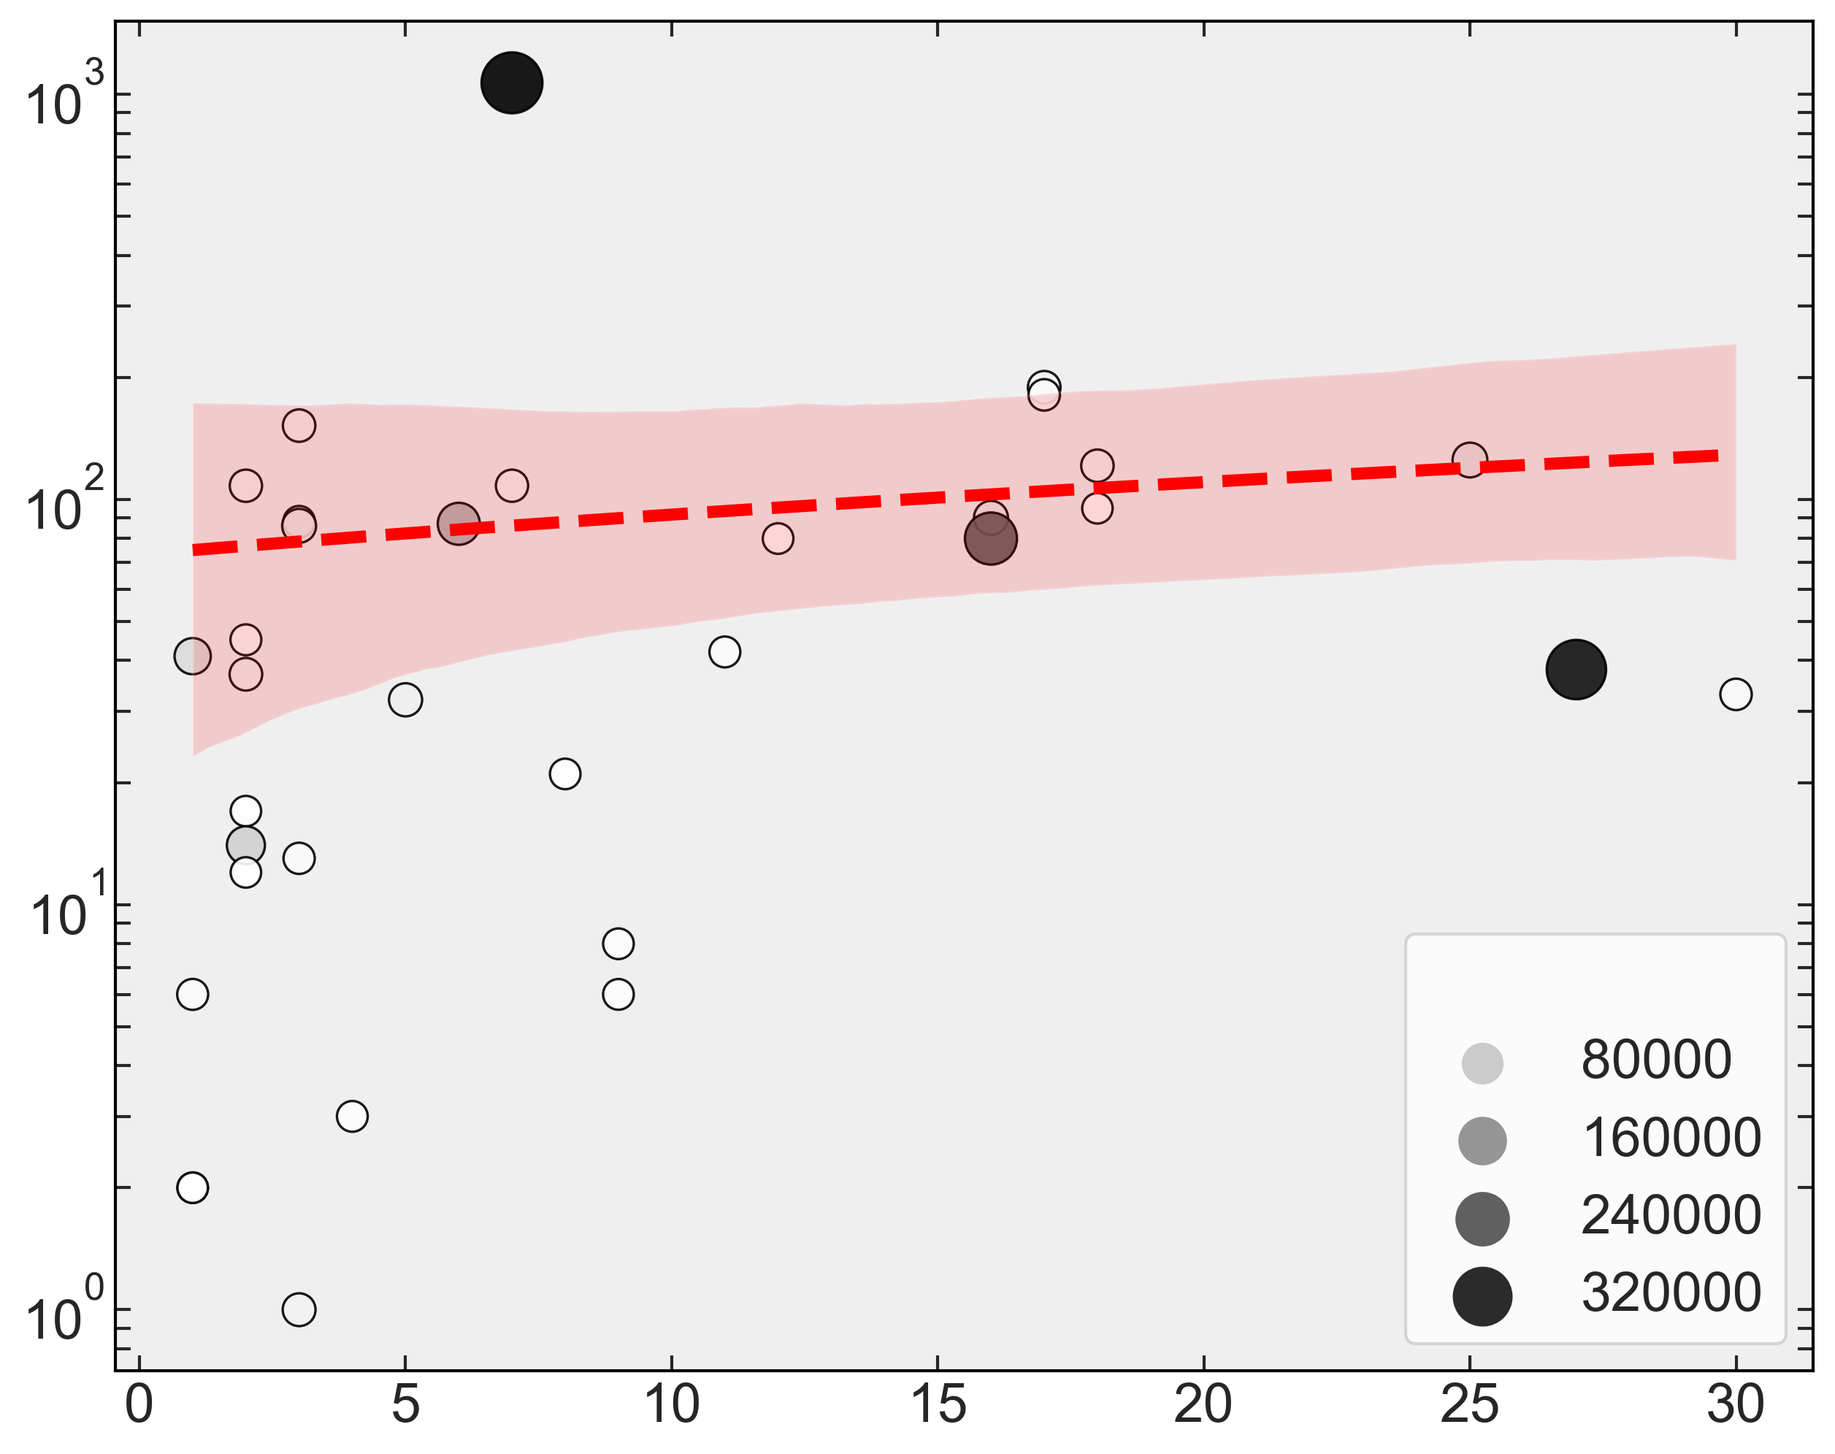
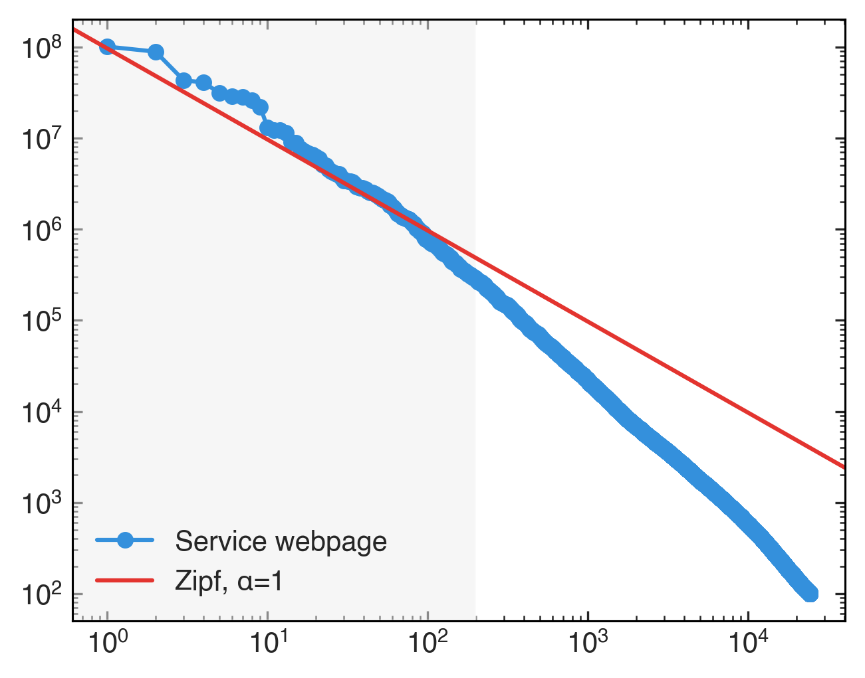
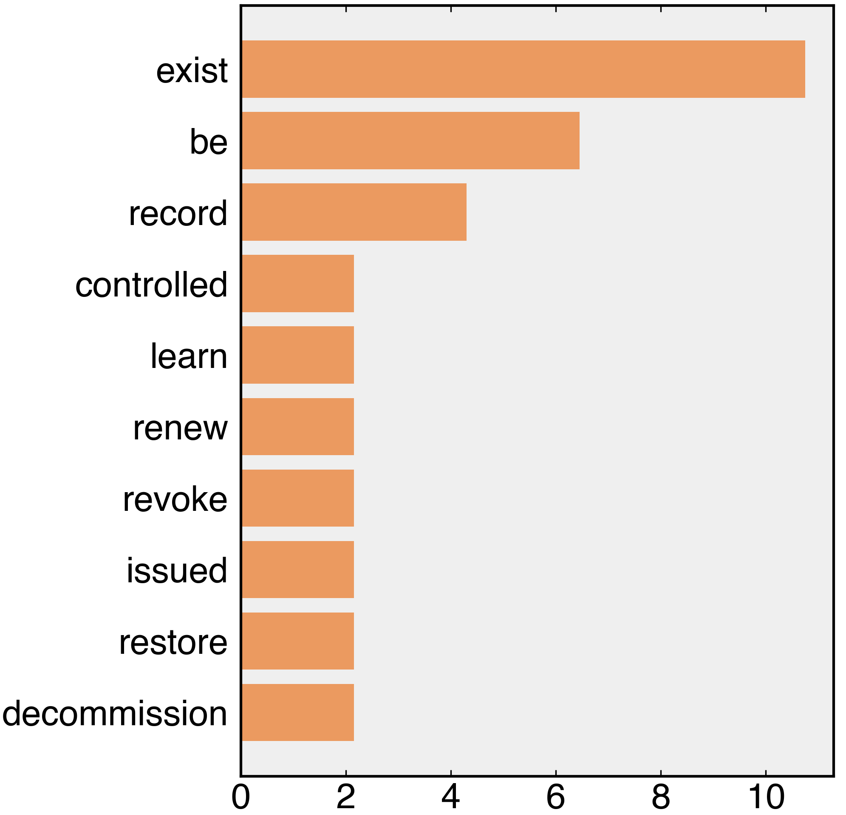
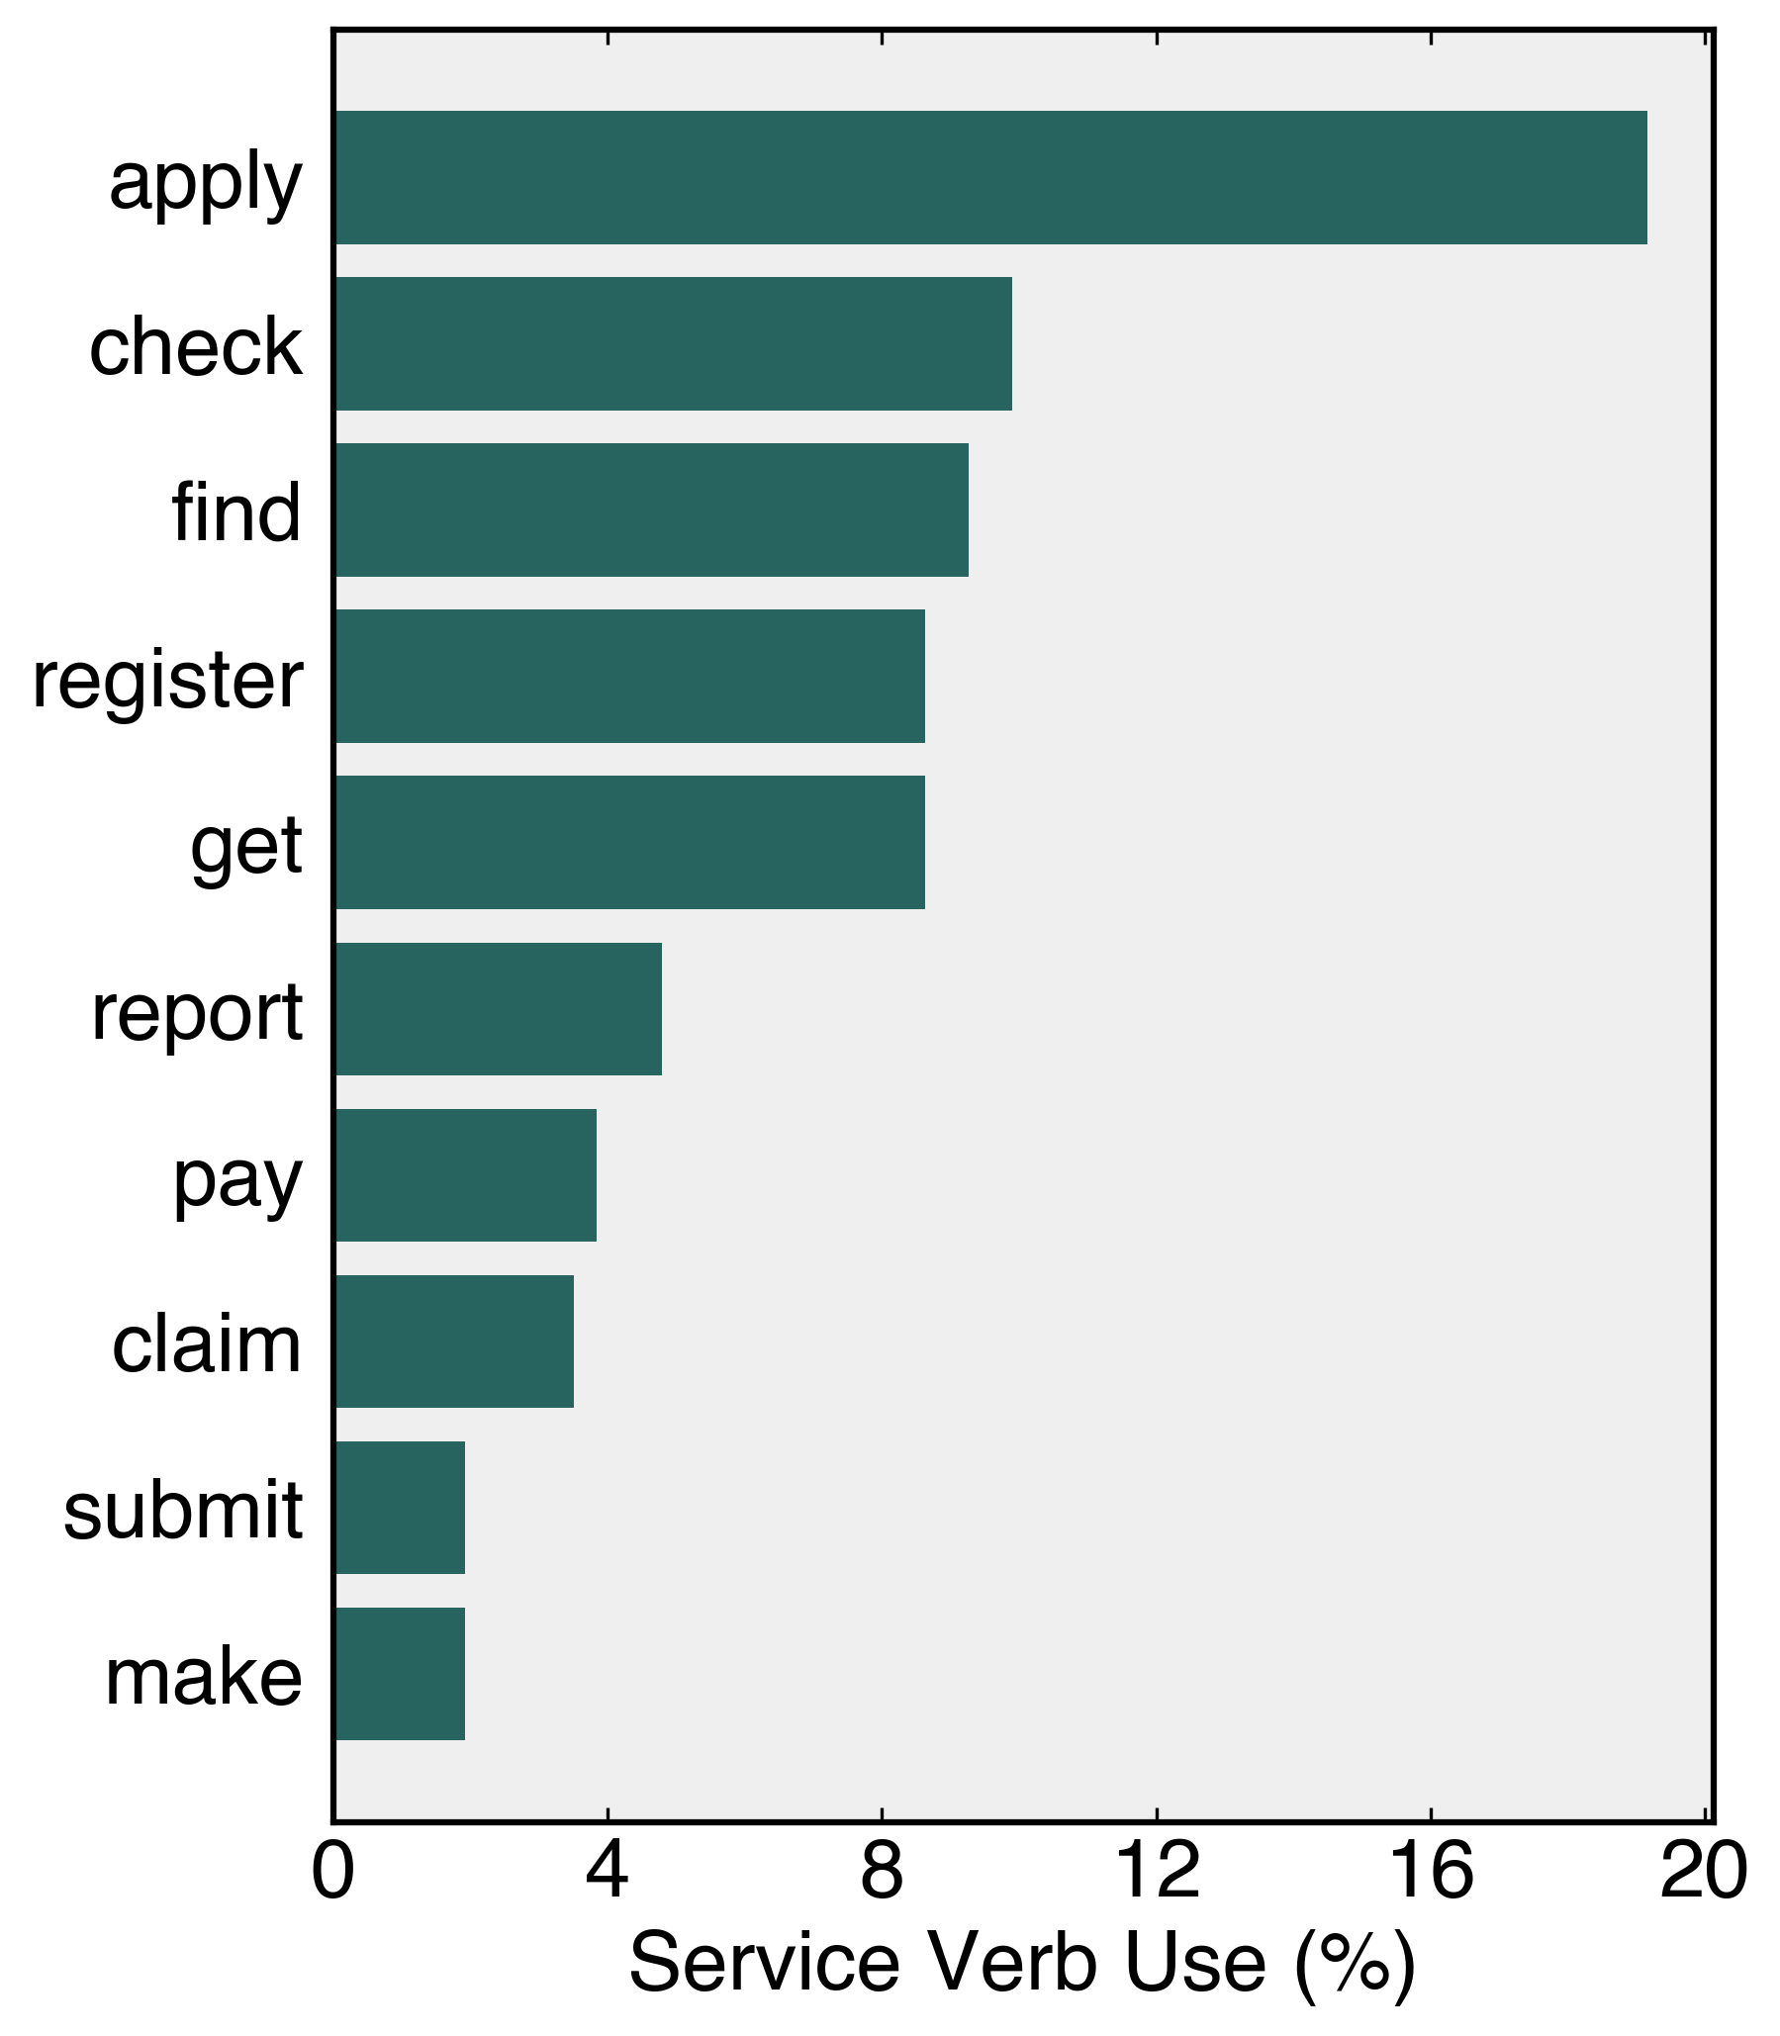
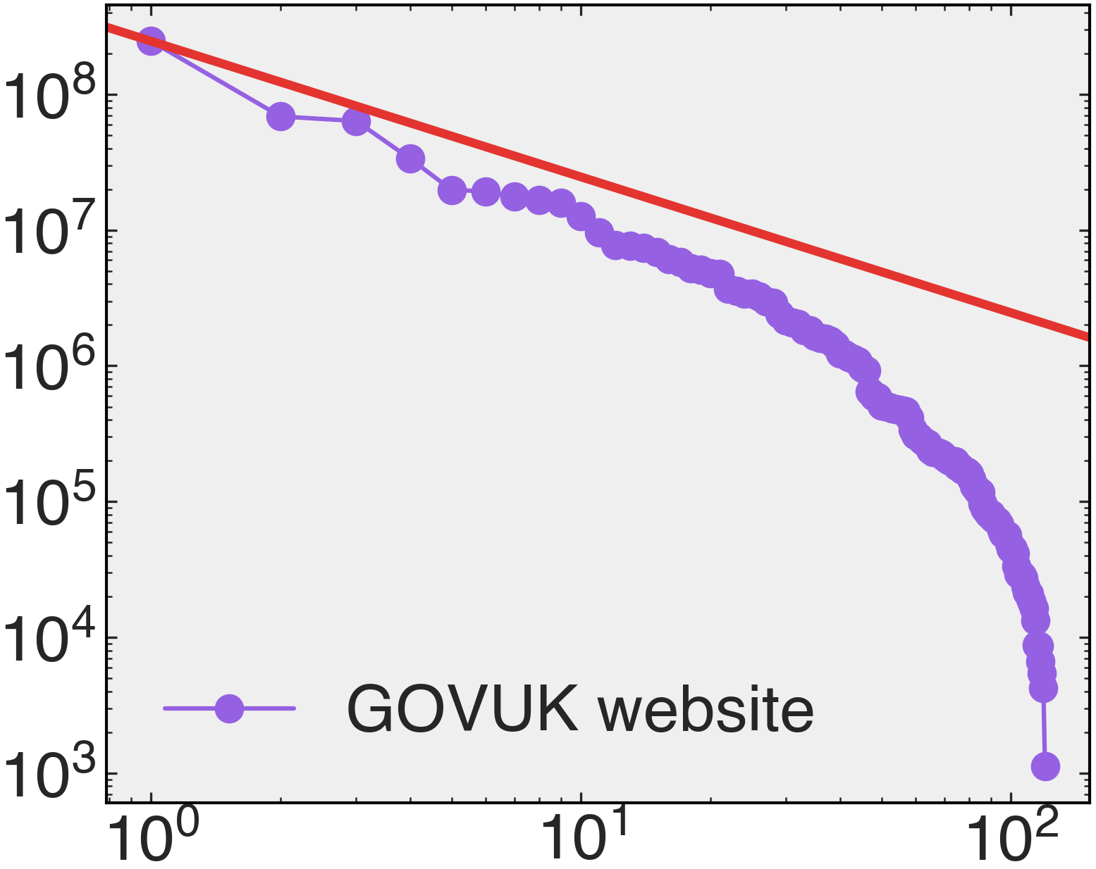
A
B
— State pension claims
— Vehicle registration
— Passport applications
— Jobseeker’s Allowance
— Jobcentre Plus
C
Pearson ρ = 0.38
D
E
2012
2022
HMCTS
/sign-in-universal-credit
/check-mot-history
# Forms
DVLA
DWP
# Visits
/report-covid19-result
Form views
# Services
Rank
Service verb use (%)
Service verb use (%)

Slide 4
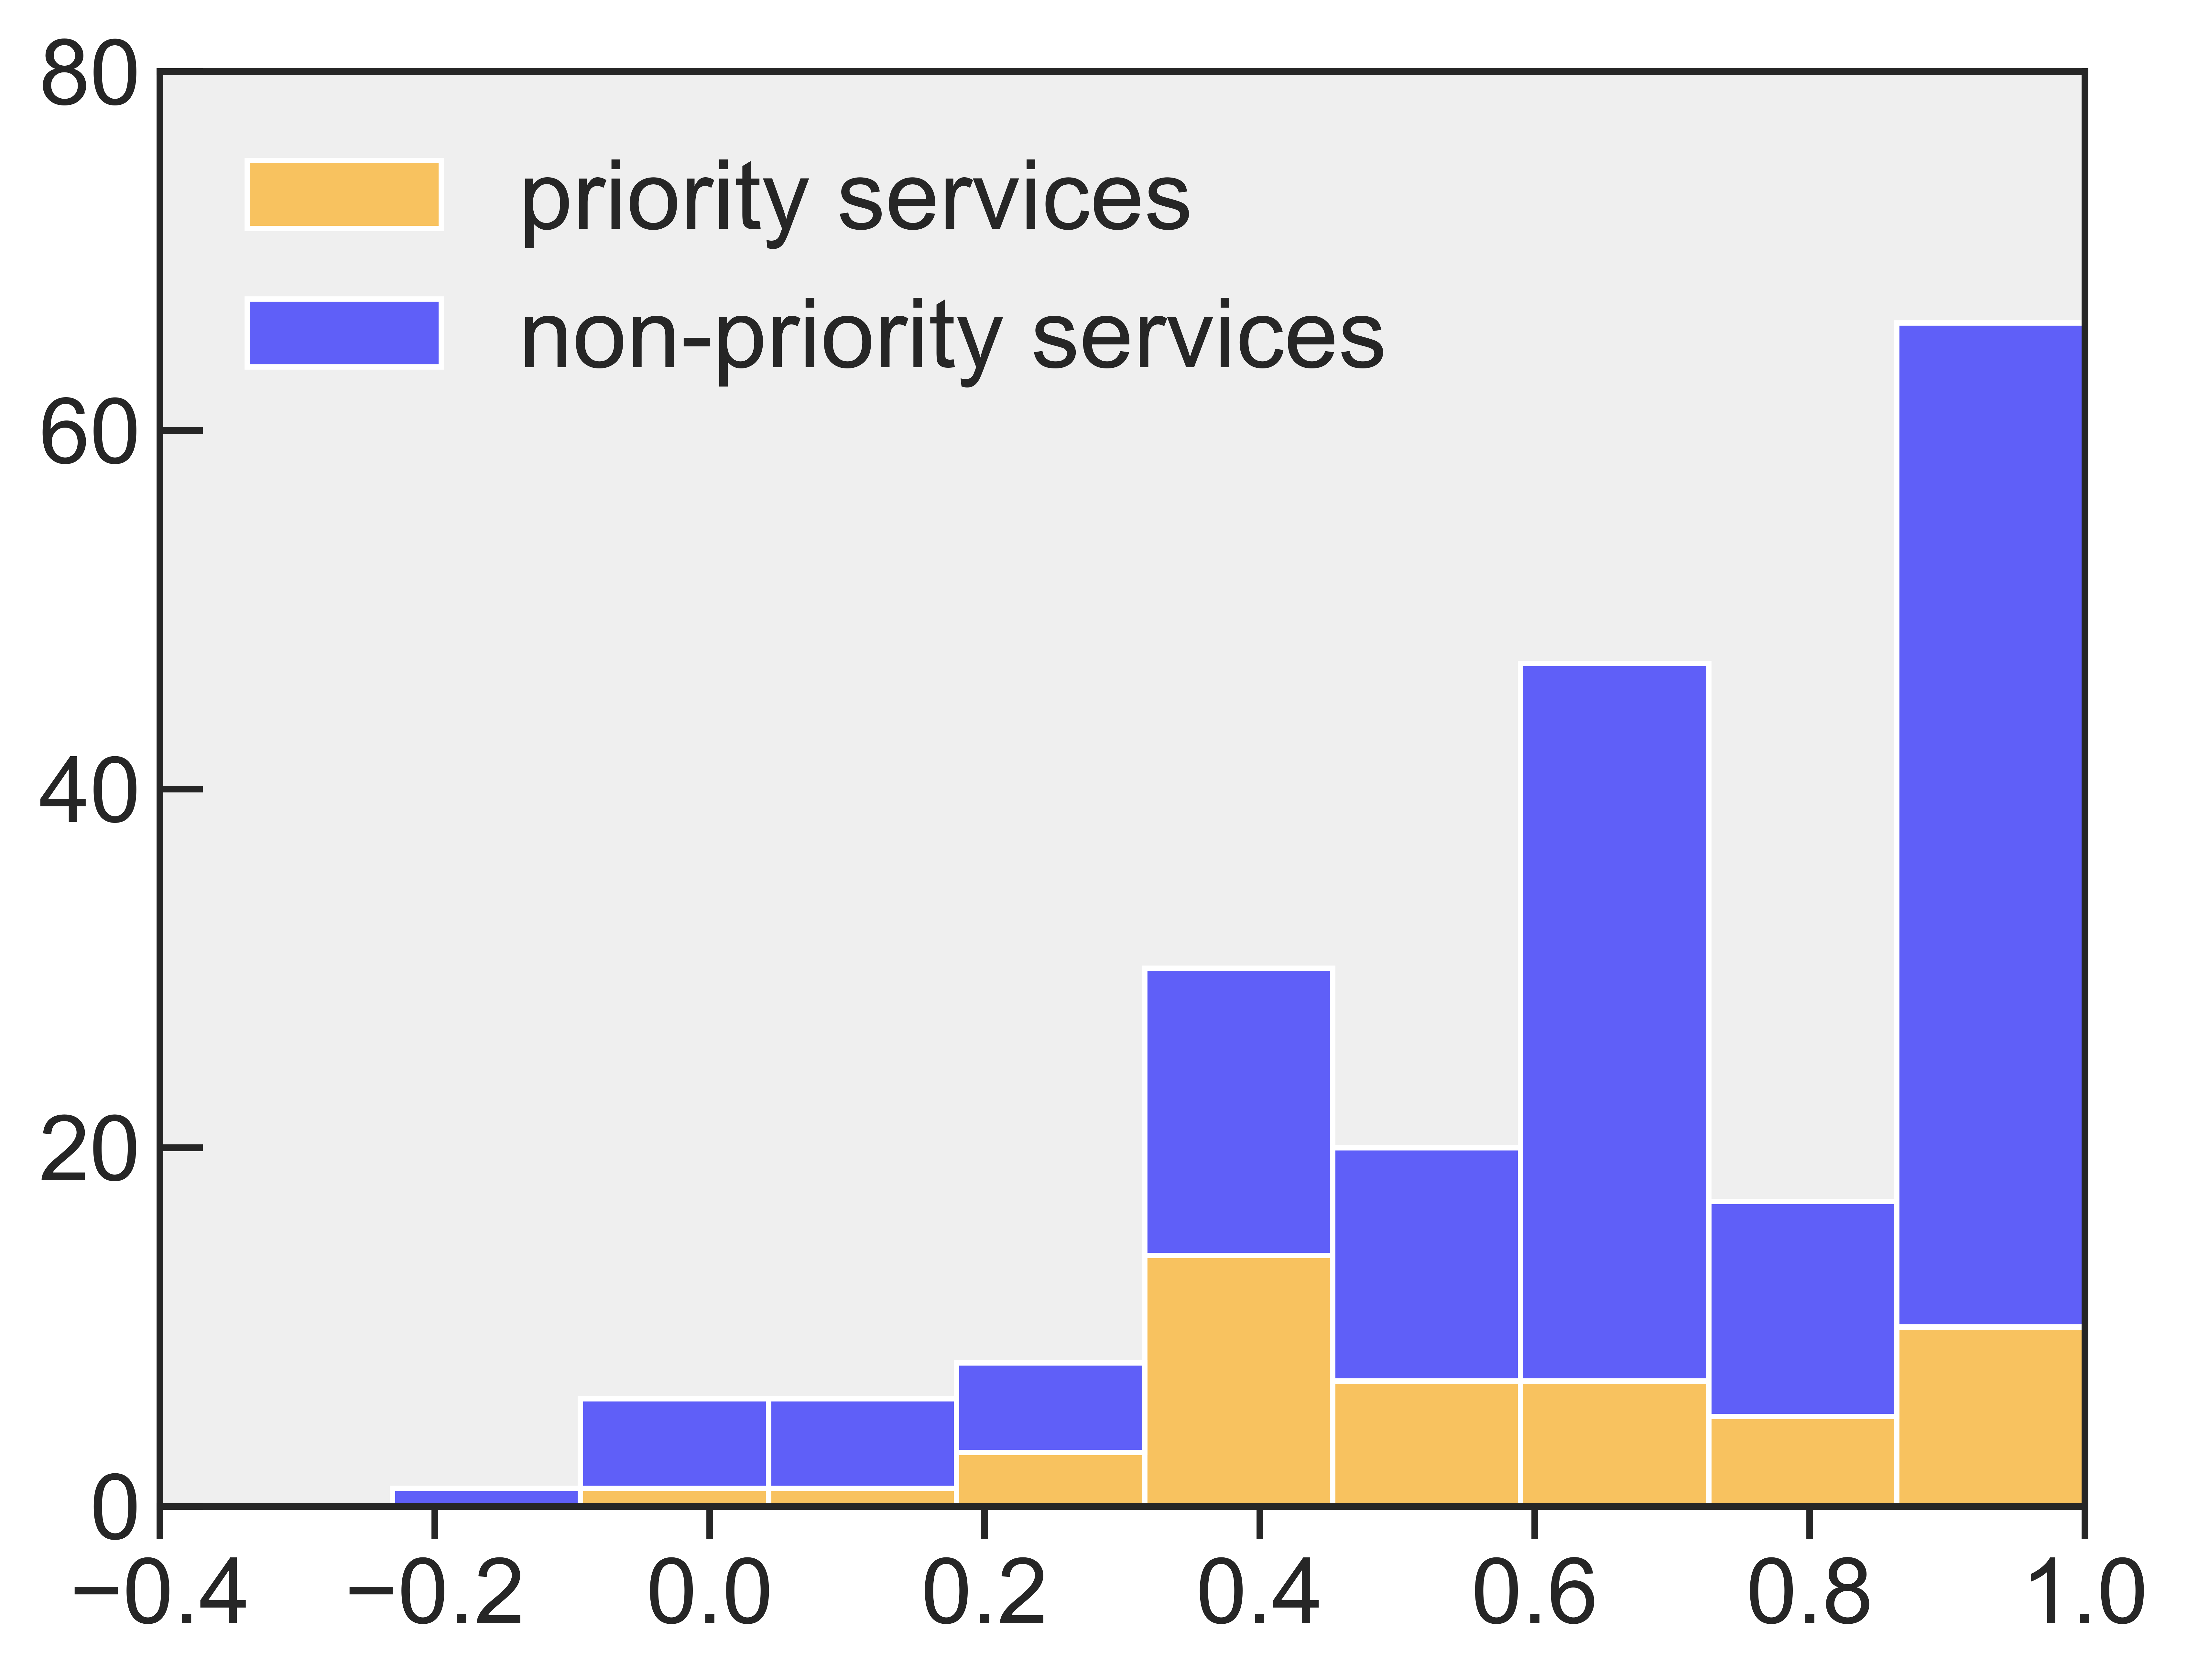
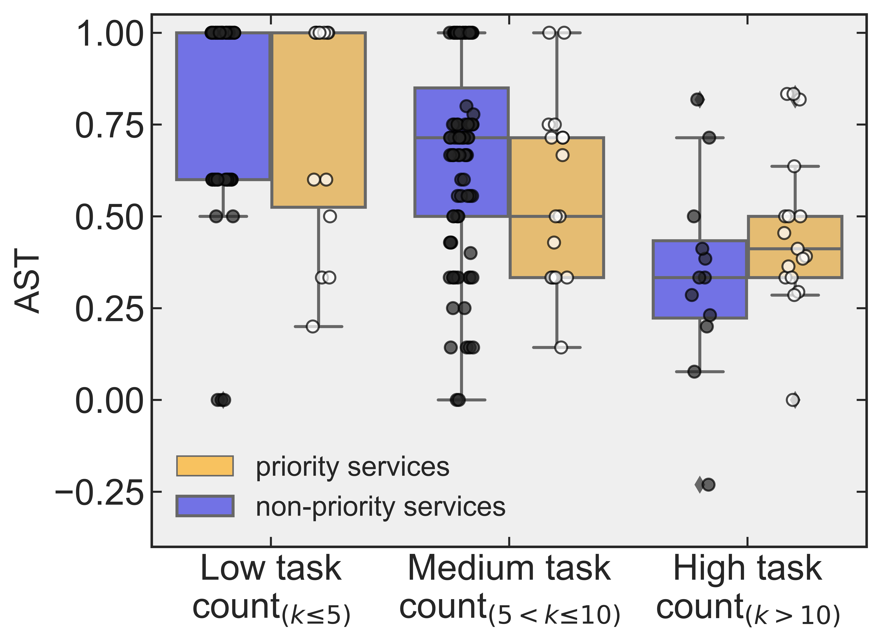
A
B
Share of routine tasks ≥ 75%
Share of
routine tasks
RTI
score
# of
services
% of
services
# of
orgs
# service delivery
professionals
0%
< 50%
≥ 50%
≥ 75%
100%
−1
< 0
≥ 0
≥ 0.5
1
0
(0)
1
(0)
200
(48)
149
(28)
66
(10)
0
(0)
0.50
(0)
99.50
(100)
74.13
(58.33)
32.84
(20.83)
0
(0)
1 (0)
46
(18)
41
(14)
30
(7)
0
(0)
10,403
(0)
76,233
(54,260)
75,523
(53,540)
70,133
(4,230)
Appeal against a visa or immigration decision
AST
C
D
# of organisations involved
Low-automatable priority services suitable
for AI augmentation (AST <0.50; n=20)
Service topics
n=1
n=4
n=7
High potential for
GenAI
• Register for an exemption from minimum energy efficiency
standards for landlords
• Environment and countryside
Medium potential for GenAI
• Apply for an access to work grant
• Apply for legal aid
• Apply for photo ID to vote
• Apply for pension credit
• Apply for deceased military record
• Apply for new style employment
• Apply for bereavement support
• Apply for a skilled worker visa
• Apply for a criminal record check
• Apply for a student visa
• Biomass suppliers list
• Claim disability living allowance
• Claim maternity allowance
• King’s award for enterprise
• Benefits
• Business and self-employed
• National security
• Visas and immigration
Low potential for
GenAI
• Apply for a standard visitor visa
• Claim attendance allowance
• National security vetting service
• Register for combined heat and power quality assurance and submit
installation data
• Get help with funeral costs (funeral expenses payment)
• Benefits
• Business and self-employed
• Citizenship and living in the UK
• Crime, justice and the law
• Environment and countryside
• Visas and immigration
• Working, jobs and pensions
Task count group

Slide 5
Supplementary material figures

Slide 6
Score | Description
High Potential (HP) | Label services high potential (HP) if direct access to a state-of-the-art generative AI model can be applied to at least three quarters of the tasks associated with the service with equivalent expected quality of service. This may include tasks that can be reduced to: writing and transforming text and code according to complex instructions; providing edits to existing text following specifications; summarizing medium-length documents; providing feedback on documents; answering questions about a document; writing questions for an interview or assessment; writing and responding to emails, including ones that involve refuting information or engaging in a written negotiation; maintaining records of written data; preparing training materials based on general knowledge; informing anyone of any information via any written or spoken medium. Services labelled as HP should additionally meet both of the following criteria in terms of methods (the ways the service delivery process is organised): (1) the provision of the service does not require any interpersonal interaction between individual users and service providers, and (2) the service provision process only involves internal administrative staff (civil servants in the respective government department or agency accountable to the permanent secretary, the most senior civil servant in the department) working together. Services labelled as HP should additionally meet one of the following criteria in terms of tools (the physical objects used for aiding the service provision process): (1) the service involves no manual document checking; (2) the service only requires users to complete webpage-based forms (e.g., HTML).
Medium Potential (MP) | Label services as medium potential (MP) if direct access to a state-of-the art AI model can be applied to at least half of the tasks with equivalent expected quality of service, and it is easy to imagine additional software that could be developed on top of the model that would allow it to be applied to more tasks. This software may include capabilities such as: summarizing and answering questions about those documents; searching over an organization’s existing knowledge, data, or documents and retrieving information; retrieving highly specialized domain knowledge; make recommendations given data or written input; analyse written information to inform decisions; prepare training materials based on highly specialized knowledge; provide counsel on issues; maintain complex databases. Services labelled as MP should additionally meet both of the following criteria in terms of methods (the ways the service delivery process is organised): (1) the provision of the service does not require any or only some interpersonal interaction between individual users and service providers, and (2) the service provision process involves internal administrative staff or internal administrative staff and an administrative tribunal (specialist court who often sit in a panel and whose judges and members hear a wide range of cases). Services labelled as MP should additionally meet one of the following criteria in terms of tools (the physical objects used for aiding the service provision process): (1) the service does not involve manual document checking; (2) the service requires users to complete webpage-based forms or document-based forms (e.g., PDF).
Low Potential (LP) | Label services LP if direct access to a state-of-the-art AI model can be applied to less than half of the tasks with equivalent expected quality of service, and it is easy to imagine additional software that could be developed on top of the model that would allow it to be applied to more tasks. This software may include capabilities such as: taking real-time video as an input and producing real-time video as an output; accurately retrieving very detailed information from image inputs, such as measurements of dimensions within an image; using domain-specific expertise to answer questions and make complex decisions that require weighing multiple factors. Services labelled as LP should additionally meet both of the following criteria in terms of methods (the ways the service delivery process is organised): (1) the provision of the service requires some or a high degree of interpersonal interaction between individual users and service providers, and (2) the service provision process involves internal administrative staff or internal administrative staff and an administrative tribunal. Services labelled as LP should additionally meet one of the following criteria in terms of tools (the physical objects used for aiding the service provision process): (1) the service involves manual document checking; (2) the service only requires users to complete document-based forms.
No Potential (NP) | Label services no potential (NP) if direct access to a state-of-the-art AI model can be applied to less than half of the tasks with equivalent expected quality of service, and it is not easy to imagine additional software that could be developed on top of the model that would allow it to be applied to more tasks. Services labelled as NP should additionally meet both of the following criteria in terms of methods (the ways the service delivery process is organised): (1) the provision of the service requires a high degree of interpersonal interaction between individual users and service providers, and (2) the service provision process involves internal administrative staff and an administrative tribunal. Services labelled as NP should additionally meet both of the following criteria in terms of tools (the physical objects used for aiding the service provision process): (1) the service involves manual document checking, and (2) the service only requires users to complete document-based forms.

Slide 7
— State pension claims
— Vehicle registration
— Passport applications
— Jobseeker’s Allowance
— Jobcentre Plus
Volume (millions)
Time (quarters)

Slide 8
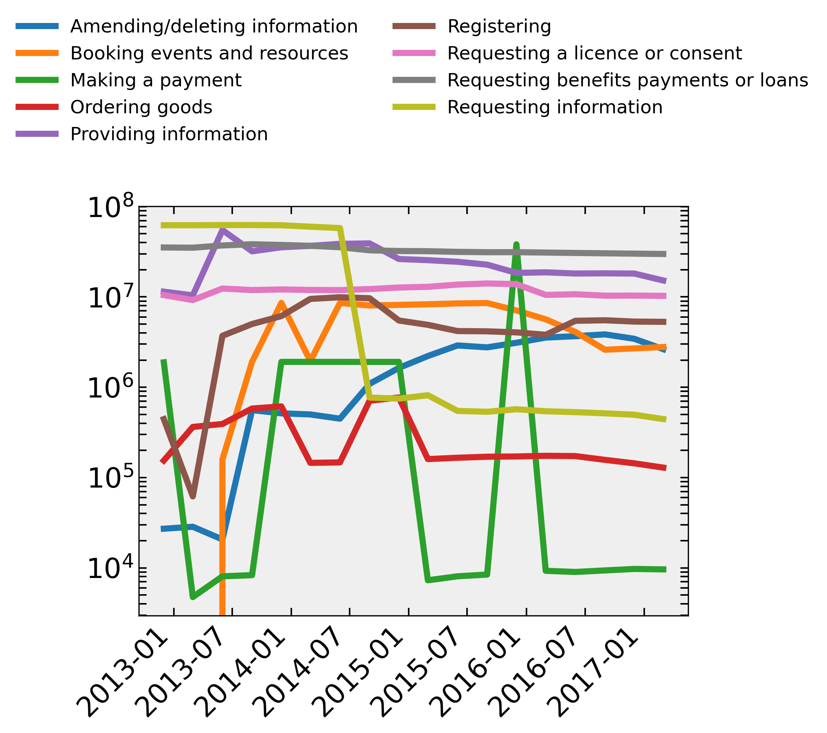
Log(Volume)
Time (quarters)

Slide 9
Pearson ρ = 0.38
HMCTS
DVLA
Log(# Forms)
DWP
Form views
# Services

Slide 10
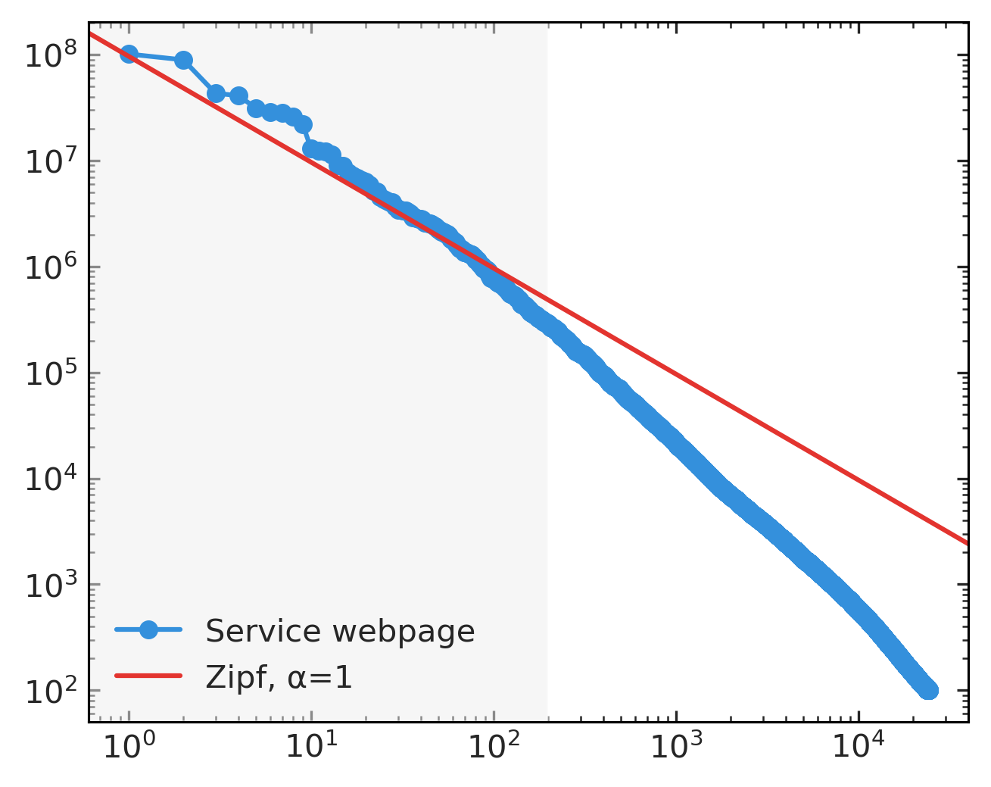
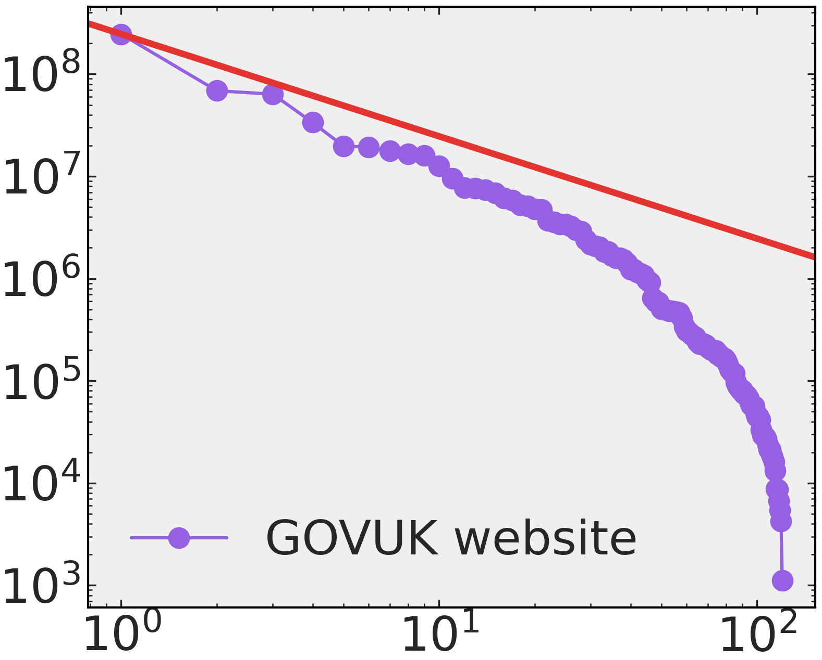
/sign-in-universal-credit
/check-mot-history
/report-covid19-result
Log(# Visits)
Log(Rank)

Slide 11
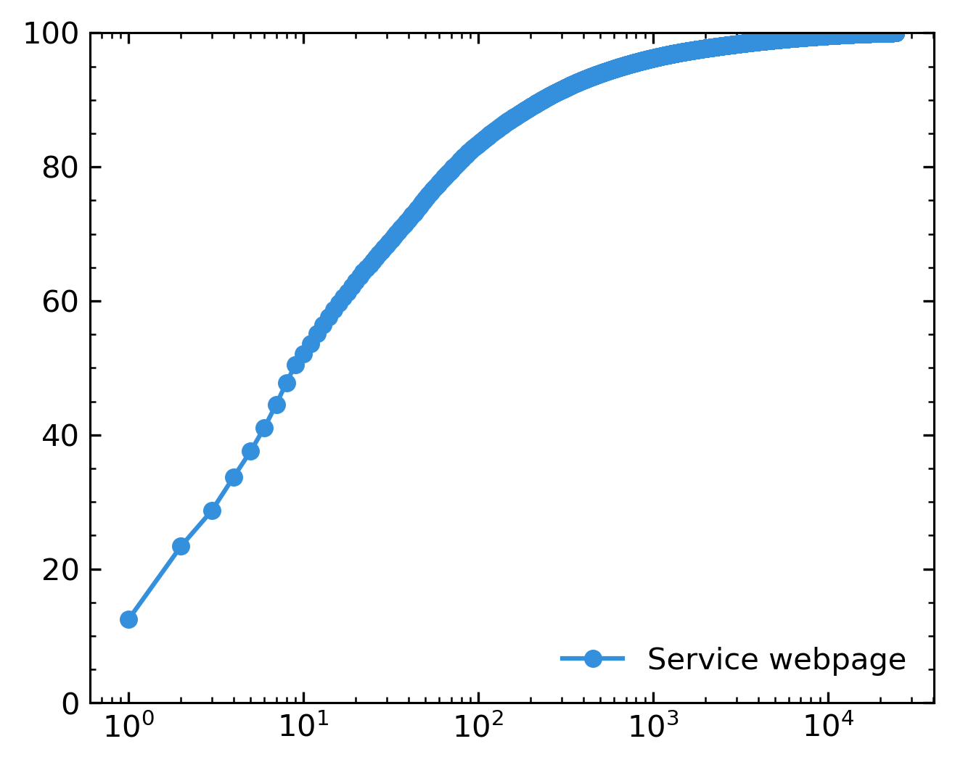
Cumulative total (%)
Log(Rank)

Slide 12
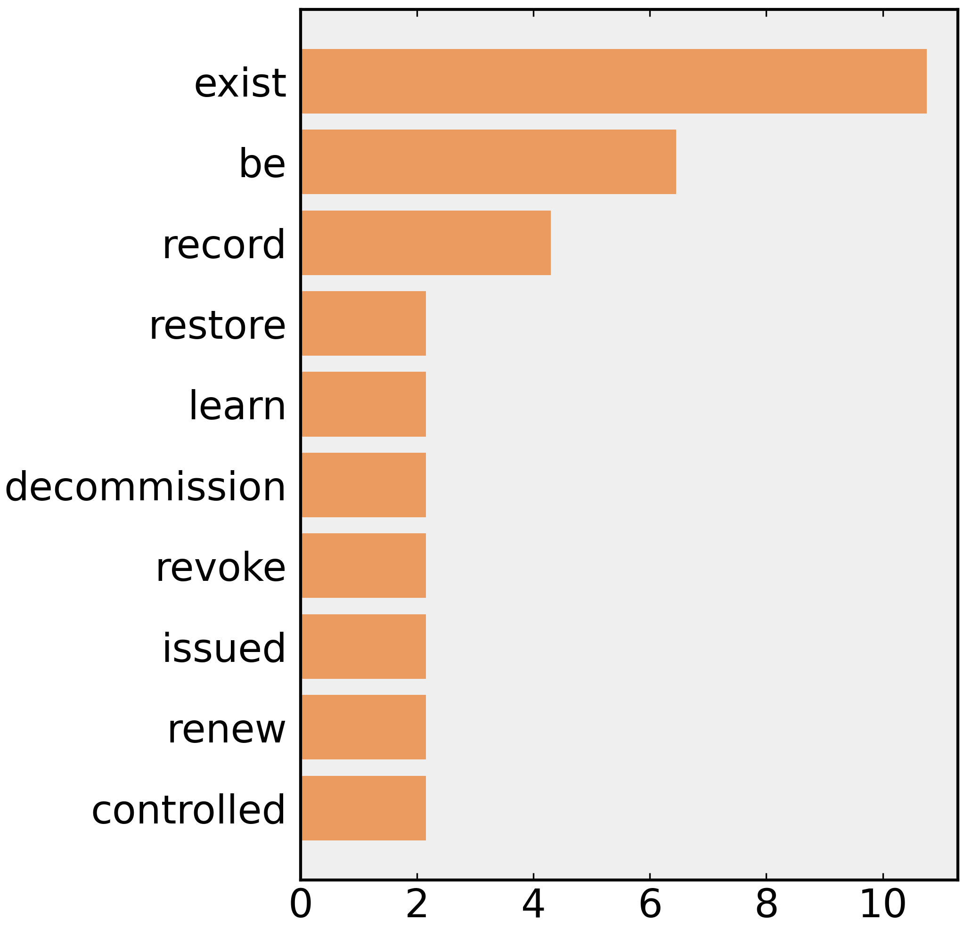
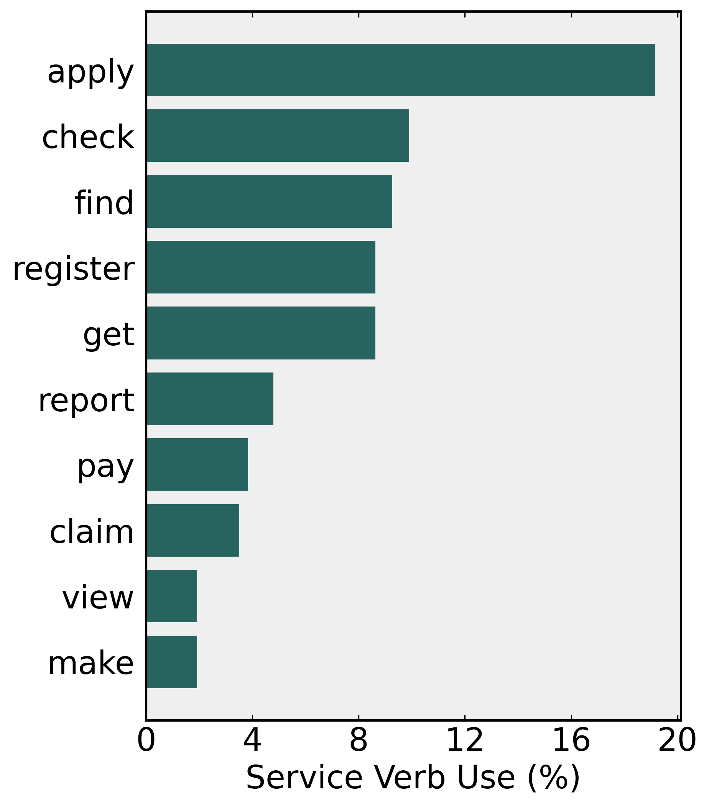
2012
2022
Service verb use (%)
Service verb use (%)

